Slide 1


DIGITAL LOGIC DESIGN
(Course Code: ECE 1003)
Module-1:Lecture-2
Number Systems

Slide 2

CONTENTS
Module-1 (Part-1)
Number systems and conversions
r’s and (r-1)’s compliment
Binary signed and unsigned numbers
Binary arithmetic operations
Weighted and non-weighted binary codes
Number Systems

Slide 3
CONTENTS
Lecture-2
Conversion of different number systems
Number Systems

Slide 4
BOOKS
Textbooks
M.Morris Mano, Michael D Ciletti, Digital Design, 5th edition, Pearson Publishers, 2013.
R.P. Jain, “Modern Digital Electronics”, 4th edition, TMH.
References
M.Morris Mano, Charles R. Kime, Tom Martin, Logic and Computer Design Fundamentals, 4th edition, Pearson Publishers.
C. H. Roth and L. L. Kinney, Fundamentals of Logic Design, 5th edition, Cengage Publishers.
Number Systems

Slide 5
Number Systems
Number Systems

Slide 6
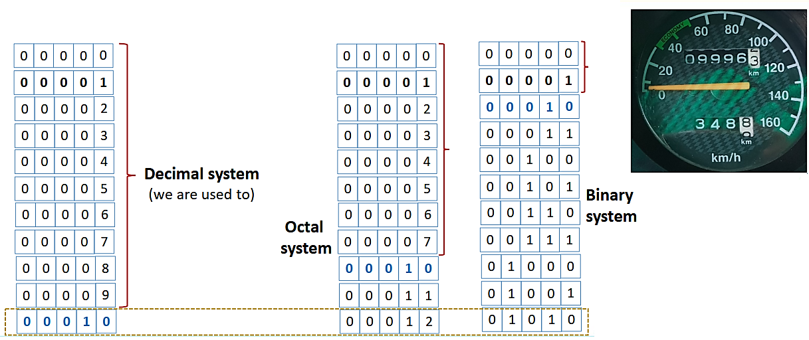
WORKING OF AN ODOMETER
Number Systems

Slide 7
NUMBER SYSTEMS
Decimal | Binary | Octal | Hexadecimal
0 | 0000 | 0 | 0
1 | 0001 | 1 | 1
2 | 0010 | 2 | 2
3 | 0011 | 3 | 3
4 | 0100 | 4 | 4
5 | 0101 | 5 | 5
6 | 0110 | 6 | 6
7 | 0111 | 7 | 7
Note:
8 = 2³,
Hence each octal number correspond to 3 binary bits
Number Systems

Slide 8
NUMBER SYSTEMS
Decimal | Binary | Octal | Hexadecimal
8 | 1000 | 10 | 8
9 | 1001 | 11 | 9
10 | 1010 | 12 | A
11 | 1011 | 13 | B
12 | 1100 | 14 | C
13 | 1101 | 15 | D
14 | 1110 | 16 | E
15 | 1111 | 17 | F
Note:
16 = 2⁴,
Hence each hexadecimal number correspond to 4 binary bits
Number Systems

Slide 9
NUMBER SYSTEMS
Decimal | Binary | Octal | Hexadecimal
16 | 10000 | 20 | 10
17 | 10001 | 21 | 11
18 | 10010 | 22 | 12
19 | 10011 | 23 | 13
20 | 10100 | 24 | 14
21 | 10101 | 25 | 15
22 | 10110 | 26 | 16
23 | 10111 | 27 | 17
Etc.
Number Systems

Slide 10
CONVERSION BETWEEN NUMBER BASES
The possibilities:
Decimal
Binary
Octal
Hexadecimal
Number Systems

Slide 11
CONVERSION FROM DECIMAL TO ANOTHER BASE
Convert an Integer from Decimal to Another Base
For each digit position:
Divide decimal number by the base (e.g. 2)
The remainder is the lowest-order digit
Repeat first two steps until no divisor remains.
Convert a fraction from Decimal to Another Base
For each digit position:
Multiply decimal number by the base (e.g. 2)
The integer is the highest-order digit
Repeat first two steps until fraction becomes zero.
Decimal
Binary
Octal
Hexadecimal
Number Systems

Slide 12
CONVERSION FROM DECIMAL TO BINARY
Decimal
Binary
Octal
Hexadecimal
Number Systems

Slide 13
CONVERSION FROM DECIMAL TO BINARY
Convert an Integer from Decimal to Binary
Example for (13)₁₀:
Integer
Quotient
Remainder
Coefficient
13/2 = 6 + 1 a₀ = 1
6/2 = 3 + 0 a₁ = 0
3/2 = 1 + 1 a₂ = 1
1/2 = 0 + 1 a₃ = 1
(13)₁₀ = (a₃ a₂ a₁ a₀)₂ = (1101)₂
Dr. Subhasish Mahapatra
Sr. Assistant Professor, SENSE
Number Systems

Slide 14
CONVERSION FROM DECIMAL TO BINARY
Convert a fraction from Decimal to Binary
Example for (0.625)₁₀ :
Integer
Fraction
Coefficient
0.625 x 2 = 1 + 0.25 a₋₁ = 1
0.250 x 2 = 0 + 0.50 a₋₂ = 0
0.500 x 2 = 1 + 0 a₋₃ = 1
(0.625)₁₀ = (0.a₋₁ a₋₂ a₋₃ )₂ = (0.101)₂
Number Systems

Slide 15
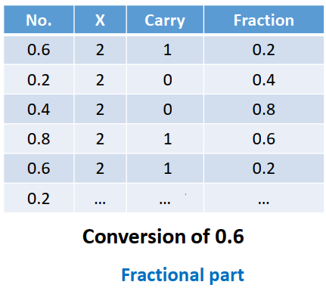
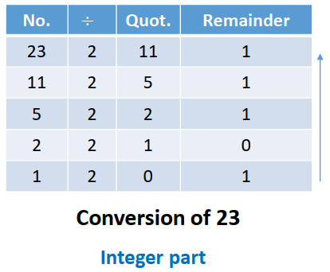
CONVERSION FROM DECIMAL TO BINARY
Example: Convert (23.6)₁₀ to binary :
(23.6)₁₀ = (10111.10011)₂ (fractional part truncated at 5 bits)
Number Systems

Slide 16

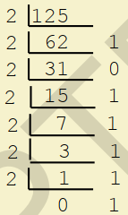
CONVERSION FROM DECIMAL TO BINARY
Example:
Trick:
2⁷ | 2⁶ | 2⁵ | 2⁴ | 2³ | 2² | 2¹ | 2⁰
128 | 64 | 32 | 16 | 8 | 4 | 2 | 1
0 | 1 | 1 | 1 | 1 | 1 | 0 | 1
(125)₁₀ = (1111101)₂
Number Systems

Slide 17
CONVERSION FROM DECIMAL TO OCTAL
Decimal
Binary
Octal
Hexadecimal
Number Systems

Slide 18
CONVERSION FROM DECIMAL TO OCTAL
Convert an Integer from Decimal to Octal
Example for (175)₁₀:
Integer
Quotient
Remainder
Coefficient
175/8 = 21 + 7 a₀ = 7
21/8 = 2 + 5 a₁ = 5
2/8 = 0 + 2 a₂ = 2
(175)₁₀ = (a₂ a₁ a₀)₈ = (257)₈
Number Systems

Slide 19
CONVERSION FROM DECIMAL TO OCTAL
Convert a fraction from Decimal to Octal
Example for (0.3125)₁₀ :
Integer
Fraction
Coefficient
0.3125 x 8 = 2 + 0.5 a₋₁ = 2
0.5000 x 8 = 4 + 0 a₋₂ = 4
(0.3125)₁₀ = (0.24)₈
Number Systems

Slide 20

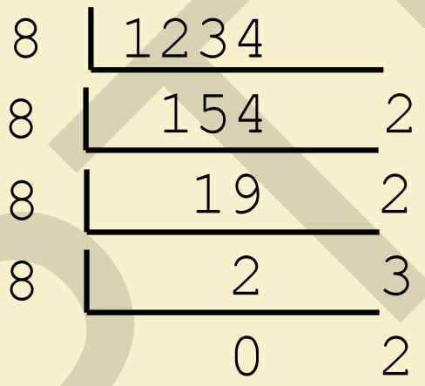
CONVERSION FROM DECIMAL TO OCTAL
Example:
(1234)₁₀ = (2322)₈
Number Systems

Slide 21
CONVERSION FROM DECIMAL TO HEXADECIMAL
Decimal
Binary
Octal
Hexadecimal
Number Systems

Slide 22
CONVERSION FROM DECIMAL TO HEXADECIMAL
Convert an Integer from Decimal to Hexadecimal
Example for (257)₁₀:
Integer
Quotient
Remainder
Coefficient
257/16 = 16 + 1 a₀ = 1
16/16 = 1 + 0 a₁ = 0
1/16 = 0 + 1 a₂ = 1
(257)₁₀ = (a₂ a₁ a₀)₁₆ = (101)₁₆
Number Systems

Slide 23
CONVERSION FROM DECIMAL TO HEXADECIMAL
Convert a fraction from Decimal to Hexadecimal
Example for (0.1275)₁₀ :
Integer
Fraction
Coefficient
0.1275 x 16 = 2 + 0.04 a₋₁ = 2
0.04 x 16 = 0 + 0.64 a₋₂ = 0
0.64 x 16 = 10 + 0.24 a₋₃ = A
- - - - - - - - - - - - - - - - -
(0.1275)₁₀ = (0.20A)₁₆
Number Systems

Slide 24

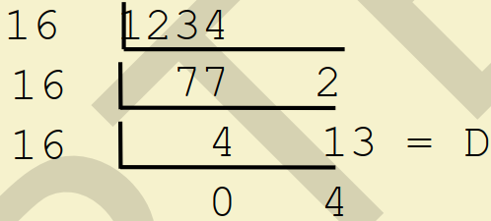
CONVERSION FROM DECIMAL TO HEXADECIMAL
Example:
(1234)₁₀ = (4D2)₁₆
Number Systems

Slide 25
CONVERSION FROM ANY BASE TO DECIMAL
Technique:
Multiply each bit by b^{n}, where n is the “weight” of the bit and b is the base.
The weight is the position of the bit, starting from 0 on the right
Add the results
Decimal
Binary
Octal
Hexadecimal
Number Systems

Slide 26
CONVERSION FROM BINARY TO DECIMAL
Decimal
Binary
Octal
Hexadecimal
Number Systems

Slide 27
CONVERSION FROM BINARY TO DECIMAL
Example: (101011)₂ = (N)₁₀
101011₂ => 1 x 2⁰ = 1 1 x 2¹ = 2 0 x 2² = 0 1 x 2³ = 8 0 x 2⁴ = 0 1 x 2⁵ = 32 43₁₀
(101011)₂ = (43)₁₀
Number Systems

Slide 28
CONVERSION FROM BINARY TO DECIMAL
Example: (10.1011)₂ = (N)₁₀
10.1011₂ => 1 x 2⁻⁴ = 0.0625 1 x 2⁻³ = 0.125 0 x 2⁻² = 0.0 1 x 2⁻¹ = 0.5 0 x 2⁰ = 0 1 x 2¹ = 2 2.6875₁₀
(10.1011)₂ = (2.6875)₁₀
Number Systems

Slide 29
CONVERSION FROM OCTAL TO DECIMAL
Decimal
Binary
Octal
Hexadecimal
Number Systems

Slide 30
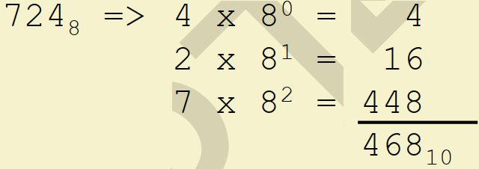
CONVERSION FROM OCTAL TO DECIMAL
Example: (724)₈ = (N)₁₀
(724)₈ = (468)₁₀
Number Systems

Slide 31
CONVERSION FROM HEXADECIMAL TO DECIMAL
Decimal
Binary
Octal
Hexadecimal
Number Systems

Slide 32
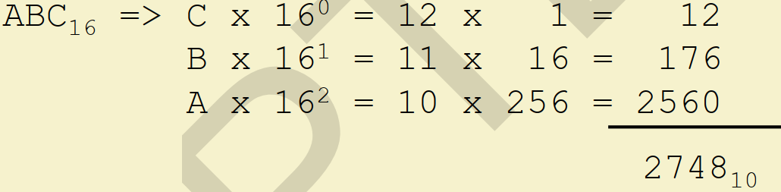
CONVERSION FROM HEXADECIMAL TO DECIMAL
Example: (ABC)₁₆ = (N)₁₀
(ABC)₁₆ = (2748)₁₀
Number Systems

Slide 33
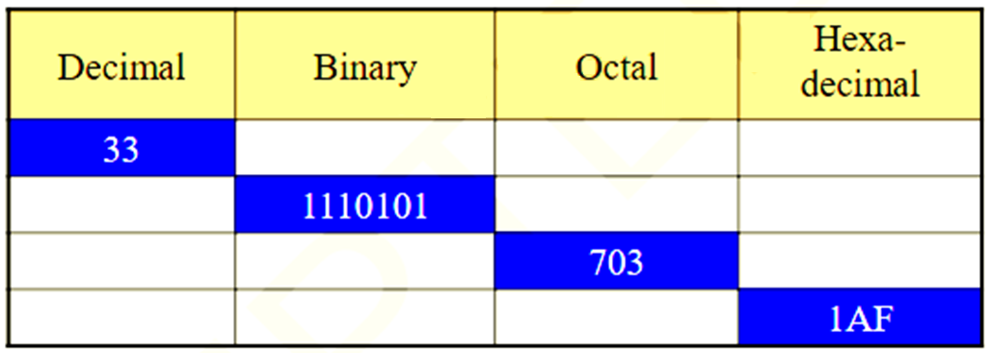
ASSIGNMENT QUESTION
Fill the table:
Number Systems

Slide 34

Please follow the instructions of the government and stay safe
Number Systems

